Slide 1

VASIREDDY VENKATADRI INSTITUTE OF TECHNOLOGY (Autonomous) Department of Computer Science and Engineering
IV B.Tech -I Semester
Web Technologies
Unit-1

Slide 2
Syllabus
UNIT-I: HTML, CSS
Basic Syntax, Standard HTML Document Structure, Basic Text Markup, Images, Hypertext Links, Lists, Tables, Forms, HTML5
CSS: Levels of Style Sheets, Style Specification Formats, Selector Forms, The Box Model,
Conflict Resolution

Slide 3
History of Internet
1968 - DARPA (Defense Advanced Research Projects Agency) contracts with BBN (Bolt, Beranek & Newman) to create ARPAnet
1970 - First five nodes:
UCLA
Stanford
UC Santa Barbara
U of Utah, and
BBN
1974 - TCP specification by Vint Cerf
1984 – On January 1, the Internet with its 1000 hosts converts en masse to using TCP/IP for its messaging
1989- WorldWIdeWeb (WWW) Created
1993- MOSAIC Created
1995- Age of Commerce Started

Slide 4
Web Programming
Web programming refers to the writing, markup and coding involved in Web development, which includes Web content, Web client and server scripting and network security.
The most common languages used for Web programming are XML, HTML, JavaScript, Perl 5 and PHP.

Slide 5
Web Programming uses two types of scripting:
Client-Side Scripting
Server-Side Scripting

Slide 6
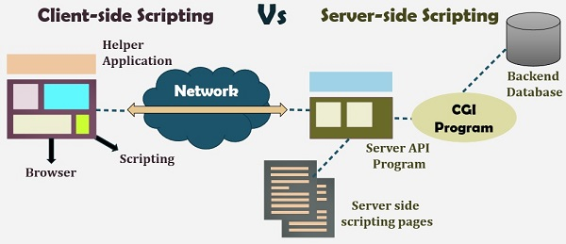

Slide 7
Client-side Scripting Vs Server-side Scripting
The scripts can be written in two forms, at the server end (back end) or at the client end (server end).
The main difference between server-side scripting and client-side scripting is that the server side scripting involves server for its processing.
On the other hand, client-side scripting requires browsers to run the scripts on the client machine but does not interact with the server while processing the client-side scripts.

Slide 8
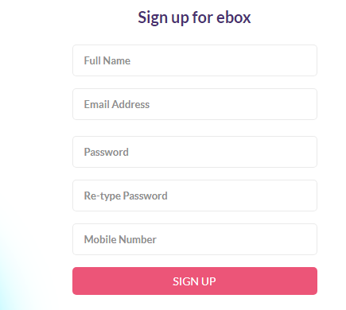

Slide 9
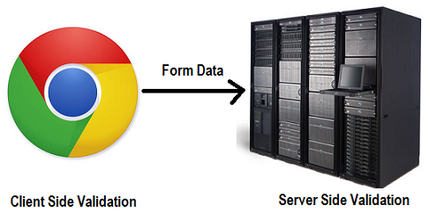
Client side validation and Server side validation

Slide 10
Contents
Introduction to HTML
Linking Documents
Images
Tables
Forms
Frames
Style Sheets
Java Script
HTML DOM

Slide 11
Introduction to HTML
Terminology
What is HTML?
HTML Versions
Creating Simple HTML Document
Structure Tags
Headings
Body Text
Forced Line Breaks
Horizontal Rules
Lists

Slide 12
WEB Terminology
WWW
Web Page
Web Server
Web Client
Web Browser

Slide 13
WWW
The World Wide Web (WWW) is most often called the Web
A distributed document delivery system
Uses a client-server model
The Web is a network of computers all over the World
All the computers in the web can communicate with each other
All the computers use a Communication standard called HTTP
Main presentation language is HTML

Slide 14
Client-Server Model
Two processes (possibly networked):
The client
Sends requests to the server
Blocks until reply is received
The server
Processes requests from clients
Never blocks
Can reply to several clients simultaneously

Slide 15
Web Page
Web information stored in documents called Web Pages.
Web pages are Electronic documents constructed using Hyper Text Markup Language
Web Site
A collection of HTML documents or Web Pages
Web Server
A Computer that stores Web Documents and makes them available
to the rest of the world.
Main function is to distribute Web pages on request
Web Client
Computers requesting the Web Pages are called Web Clients.

Slide 16
Web Browser
Web Clients view the pages with a program called a Web Browser.
Ex: Internet Explorer ,Netscape Navigator, Mozilla Firefox, etc.
The way web pages are displayed depends not only on the browser but also on the clients settings
Web Standards
The rule-making body of the web is the W3C.
W3C stands for World Wide Web Consortium.
The most essential Web standards are HTML, CSS and XML.

Slide 17
What is HTML?
Hyper Text Markup Language are the instructions that tell a browser how to lay out the information (text, images, etc) in the browser window.
A markup language designed for the creation of web pages and other information viewable in a browser
The basic language used to write web pages
Hypertext is text viewed on a browser that contains clickable entries called links or hyperlinks.
When a link or hyperlink is clicked, the document specified by the link is displayed.
A Markup language specifies code for formatting, both the layout and style, within a text file. The code used to specify the formatting are called tags
File extension: .htm, .html
Notes:
A little bit history about hypertext. Originated from Vannevar Bush, hypertext is an idea of linking documents together to make it easier to keep track of relationships between documents. The concept is more focus on individual, instead of a global system linking documents from many sources.

Slide 18
Versions Released
HTML 1.0 : Original version
HTML 2.0 : Few additional features were added
HTML 3.0 : Introduced new tags and attributes called
Netscape Extension Tags
HTML 3.2 : W3C in 1994 developed WILBUR standard
HTML 4.0 : Code named as COUGAR
XHTML 1.0 : EXtensible Hyper Text Markup Language
HTML 5.0 : Released in the year 2014

Slide 19
Tags are :
surrounded with angle brackets like this
<B> or <I>.
Most tags come in pairs.
The first tag turns the action on, and the second turns it off.
The second tag(off switch) starts with a forward slash.
For example ,<B> text </B>
can embedded, for instance, to do this:
<HEAD><TITLE> Your text </HEAD></TITLE> it won't work.
The correct order is
<HEAD><TITLE> Your text </TITLE></HEAD>
not case sensitive.
Many tags have attributes.
For example, <P ALIGN=CENTER> centers the paragraph
following it.
Some browsers don't support the some tags and some attributes.

Slide 20
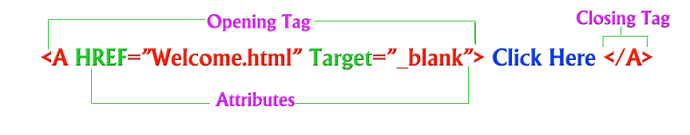
Attributes…
Are optional parts of tags
Are to be specified in start tag
Are to be separated with white spaces rather than commas
Value containing special characters must be enclosed in between
double quotation(“ ”) marks.

Slide 21
Comments in HTML
The comment in html can be denoted as follows.
<!– It is a comment statement-->

Slide 22
Creating a Simple HTML Document
Open Notepad
Click on File -> Save as…
In the File name pull-down box, type in webpage.html
Click on Save
Type in content for your file
Once you finished the content, click on File -> Save

Slide 23
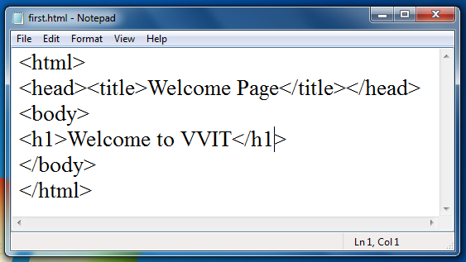
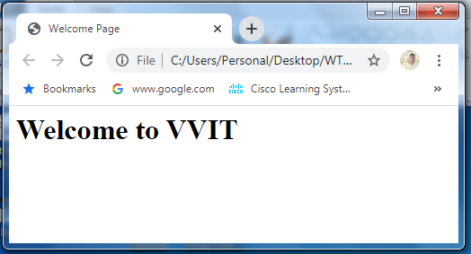
Basic HTML Document Format
See what it
looks like:

Slide 24
Structure Tags
<! DOCTYPE..>
The <DOCTYPE> tag tells browsers the HTML version with which the document compiles
<HTML>
The <HTML> tag identifies the document as an HTML Document
<HEAD>
The <HEAD> tag contains information about the document including its title, scripts used, style definitions and document descriptions
<TITLE>
The <TITLE> tag contains the document title
<BODY>
The <BODY> tag encloses all the tags, attributes and information that we want a visitor browser to display
<META>
<META> tag provides metadata about the HTML document. Meta elements are typically used to specify page description, keywords, author of the document, last modified, and other metadata.

Slide 25
HTML5 Syntax
<!doctype html>
<html lang="en">
<head>
<meta charset="utf-8">
<title>The HTML5 Herald</title>
</head>
<body>
<h1>First HTML Webpage</h1>
</body>
</html>

Slide 26
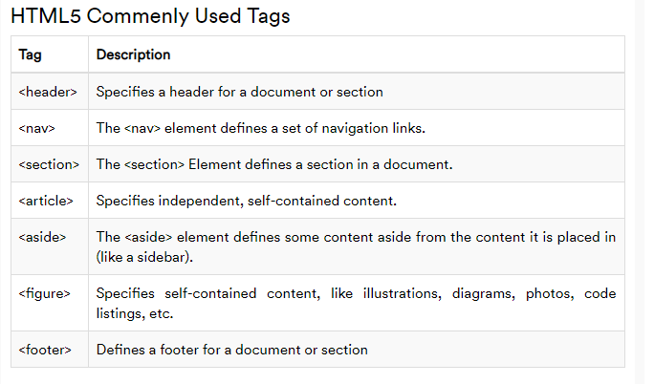

Slide 27
Headings
Headings break up a large areas of text, announce topics to follow, and arrange information according to a logical hierarchy
HTML has six levels of headings
Syntax
Program
Where y is a number between 1 and 6 specifying the level of heading
List of values for align attribute
Program
Left
Center
Right

Slide 28
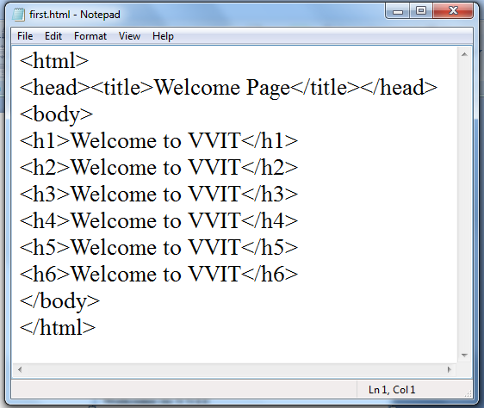
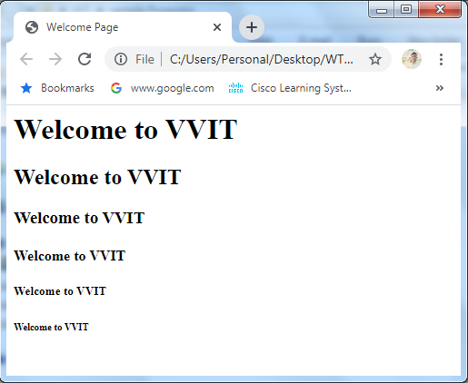

Slide 29
Body Text
Body text is text that you use within the <BODY> tags
Body text tags and attributes are divided into two categories
That is
For formatting sections and of text
Paragraph level tags and attributes
For formatting individual letters or words
Character level tags and attributes

Slide 30
Commonly used paragraph
level tags
Example
Example
Example

Slide 31
Common Character Formatting
Tags
<B> Boldface </B>
<BLINK> Blinking text </BLINK>
<CITE> indicates citations or references </CITE>
<CODE> Program Code </CODE>
<EM> Applies emphasis </EM>
<I> Applies Italics</I>
<S> Strike through text </S>
<STRIKE>Strike through text </STRIKE>
<SUB> Subscripted text </SUB>
<SUP> Superscripted text </SUP>
<TT> Applies a fixed-width font</TT>
<U> Underlined text </U>
<VAR> Variables or arguments </VAR>
* Unprofessional
* Similar to <PRE>
* Deprecated in HTML

Slide 32
Font
To change text size
<font size=“+3”>Hello</font>
Output: Hello
To change text color
<font color=“red”>Hello</font>
Output: Hello
Using both
<font size=“+3” color=“red”>Hello</font>
Output: Hello
Tag attribute
Notes:
Tags can have attributes. Attributes can provide additional information about the HTML elements on your page.
Attributes always come in name/value pairs like this: name="value".
Attributes are always added to the start tag of an HTML element

Slide 33
Horizontal Rules
Horizontal rules are lines that break up long section of text,indicate shift in information, or help improve the over all document design .
To use Horizontal rule include the <HR> tag
Attribute | Effect
Size= | Specifies rule height
Width= | Specifies rule width
Align= | Specifies alignment
Noshade | Specifies that rule has no shading

Slide 34
Lists
Lists are a great way to provide information in a structured,
easy-to-read format.
Three varieties of Lists
Numbered (Ordered)
Bulleted (unordered)
Definition

Slide 35
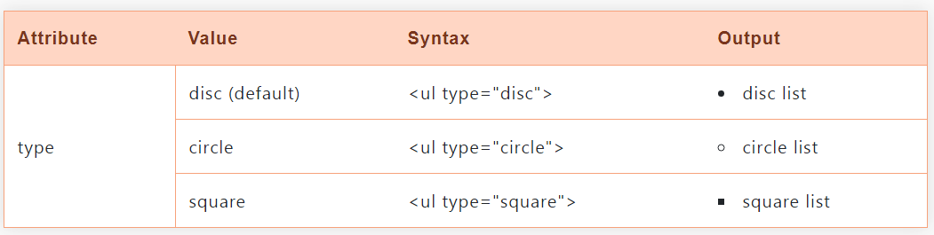
Unordered List
An unordered list is a collection of related list items that have no special order or sequence.
Unordered list is created by using HTML <ul> tag, each item in the list is defined with <li> tag, and will be displayed as a bullet.

Slide 36
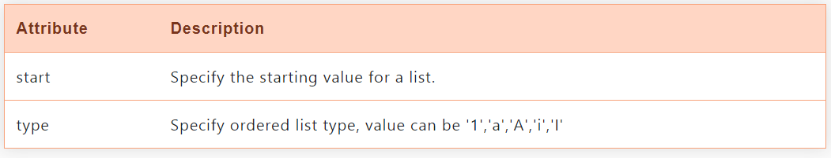
Ordered List
If we are required to put our list items in a number or in a sequence instead of bullets then HTML ordered list is useful. <ol> tag is use to create HTML Ordered List.

Slide 37
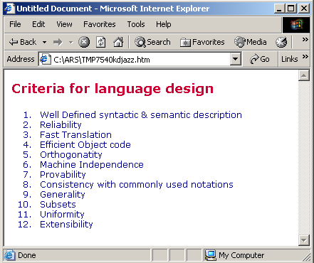

Slide 38
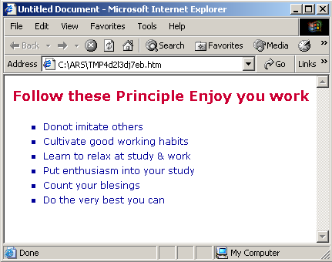

Slide 39
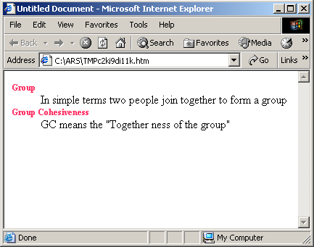
Definition List
<dl> <dt>Group <dd>In simple terms two people join together to form a group</dd> <dt>Group Cohesiveness <dd>GC means the "Together ness of the group"</dd> </dl>

Slide 40
HTML
Linking Your Documents

Slide 41
CREATING HYPERLINKS
Links connect the pages of the web, letting the user to navigate to a new page just by clicking the link. The power of HTML comes from its ability to link text or an image to another document or section of a document.
HTML’s single hypertext-related tag is <A>(anchor). To include an anchor in HTML document:
<a href="analysis.htm" target="main">Analysis</a>
will load analysis.htm to main frame
target can also have
_blank loads the page into a new browser window
_self loads the page into the current window.
_parent loads the page into the frame that is superior to the
frame the hyperlink is in.
_top cancels all frames, loads in full browser window.

Slide 42
SETTING HYPERLINK COLORS
Color can be given as RGB triplet or predefined named color. Use the following attributes of the <BODY> element:
LINK: Color of hyperlinks that have not yet been visited
VLINK: Color of hyperlinks that have been visited
ALINK: Color of hyperlinks as they have been clicked
Example:
<BODY LINK=”GREEN” VLINK=”BLUE” ALINK=”RED”>
<BODY LINK=”#00ff00” VLINK=”#0000ff” ALINK=”#ff0000”>
<BODY LINK=RGB(0,255,0) VLINK=RGB(0,0,255) ALINK=RGB(255,0,0)>

Slide 43
HTML
Images

Slide 44
IMAGES IN WEB PAGES
Images are stored outside the web page. Most Web browser can display images that are in Bitmap, GIF, to JPEG format. Each page takes time to process and slows down the initial display of a document, so carefully select your images and the number of images in a document. To include an image <IMG> tag is used by specifying the width and height attributes, which define the size of the image in pixels.
<IMG SRC=”fisrtimage.gif” HEIGHT=100 WIDTH=150>

Slide 45
ATTRIBUTES WITH IMAGES
ALT attribute is used to specify the text to be displayed in place of an image for browsers that can not handle graphics or have graphics disabled.
ALIGN sets the alignment of text, which follows the IMG reference relative to the image on the screen. Possible settings are LEFT, RIGHT, TOP, MIDDLE, and CENTER Alignment of the image in the browser window and the text that follows will wrap around the image according to the setting used.
BORDER sets whether or not the image has a border, and if so, how thick the border is.
HSPACE sets the horizontal spacing (both left and right sides) around the image in pixels.
VSPACE sets the vertical spacing (both top and bottom sides) around the image in pixels.

Slide 46
3 primary image formats used on the web:
JPEG - Joint Photographic Experts Group
PNG.-Portable Network Graphics
GIF - Graphics Interchange Format

Slide 47
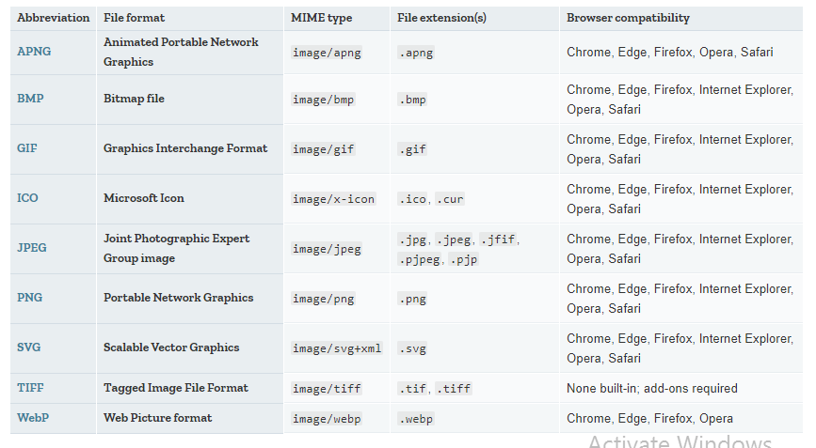
Image formats

Slide 48
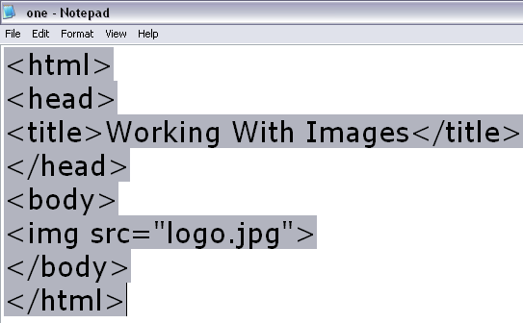
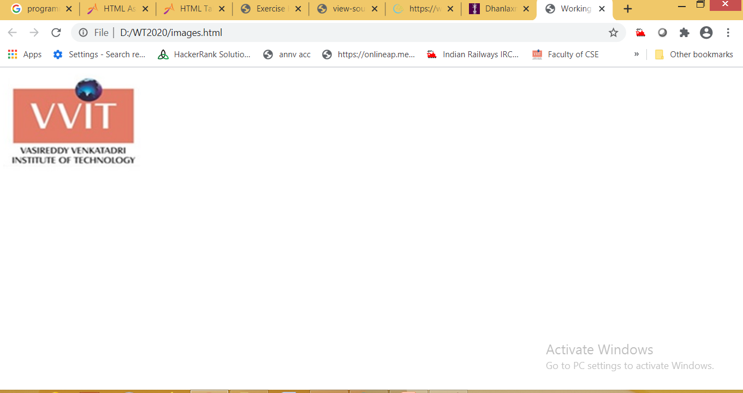

Slide 49
HTML
Tables

Slide 50
CREATING TABLES
Tables are used for information as well as for layout. One can stretch tables to fill the margins, specify a fixed width or leave it to the browser to automatically size the table to match the contents.
The <TABLE> element acts as the container for the table.
The <TR> element acts as a container for each table row.
The <TH> and <TD> elements act as containers for heading and data cells respectively.
<CAPTION> and its closing tag contains the title of the table. The default position of the title is centered at the top of the table. The attribute ALIGN=BOTTOM can be used to position the caption below the table. Any kind of markup tags can be used in the caption

Slide 51
ATTRIBUTES FOR TABLE
Following are the attributes of the <Table> element:
ALIGN: Specifies the horizontal alignment of the table in the browser window. Set to LEFT, CENTER or RIGHT.
BACKGROUND: Specifies the URL of a background image to be used as a background for the table. All cell contents are displayed over this image.
BGCOLOR: Sets the background color of the table cells. Set to a RGB triplet or a predefined color name.
BORDER: Sets the borer width in pixels. 0 indicates no border.
BORDERCOLOR: sets the external border color for the entire table
CELLPADDING: Sets the spacing between cell walls and cell contents in pixels
CELLSPACING: Sets the distance between cells in pixels
HEIGHT: Gives the height of the whole table in pixels
WIDTH: Sets the width of the table; sets to a pixel value or a percentage of the display area.

Slide 52

TEXTALIGNMENT WITHIN CELLS
By default browsers center heading cells <TH>, and left align data cells <TD>. One can change alignment using the ALIGN attribute, which can be added to each cell <TD> element or to the row <TR> element or to the table heading <TH> element or to caption for a table. It is used with the values "LEFT", "CENTER" or "RIGHT":
The VALIGN attribute plays a similar role for the vertical alignment and can be added to <TR>, <TH>, <TD> or <CAPTION> elements in a table. It is used with the values "TOP", "MIDDLE" or "BOTTOM".
Element | Attributes
<TR> | BGCOLOR, BORDERCOLOR, ALIGN
<TH> | BACKGROUND, BGCOLOR, BORDERCOLOR, COLSPAN, ROWSPAN, HEIGHT, WIDTH
<TD> | BACKGROUND, BGCOLOR, BORDERCOLOR, COLSPAN, ROWSPAN, HEIGHT, WIDTH

Slide 53
SPANNING COLUMNS AND ROWS
For some data which spans more than one row and some data spans more than one column, by setting the ROWSPAN and COLSPAN attributes respectively one can make the table.
ROWSPAN: Indicates how many rows of a table this cell should span. Set to a positive integer (the default is 1).
<TH ROWSPAN="2">Year</TH>
COLSPAN: Indicates how many columns of a table this cell should span. Set to a positive integer (the default is 1).
<TH COLSPAN="3">Sales</TH></TR>
BORDERLESS TABLES
These are commonly used for laying out pages in a gridded fashion. Set BORDER="0" and CELLSPACING="0" to the table element. Set the CELLSPACING attribute otherwise there will be a thin gap between the cells:
Example:
<TABLE BORDER="0" CELLSPACING="0" CELLPADDING="10">

Slide 54
HTML
Forms

Slide 55
Forms
A form is an area that can contain form elements.
<form></form>
Commonly used form elements includes:
Text fields
Radio buttons
Checkboxes
Submit buttons
Notes:
Many Web applications require that a user to provides some input. Typically a user fills out a form by filling in some fields with text and/or selecting from lists of options. HTML forms provide a mechanism for including many input boxes (and buttons) that the user can use to provide input to a web application.

Slide 56
The Label Element <label>
Associates a text label with a form control
Two Different Formats: <label>Email: <input type="text" name="CustEmail" id ="CustEmail"></label>
Or <label for="email">Email: </label> <input type="text" name="CustEmail" id= "email" />

Slide 57
Text Input Fields
Used when you want the user to type letters, number, etc.
<form>
First name: <input type="text" name="firstname">
<br>
Last name: <input type="text" name="lastname"> </form>
Output
First name:
Last name:
Notes:
TEXT is the most common type of input field, it allows the user to type in a single line of text. There are some additional attributes that can control the maximum length of the field (MAXLENGTH).

Slide 58
Password Fields
Used when you want the user to type letters, number, etc.
<form>
Password: <input type=“password" name=“pwd">
</form>
Output
Password:
***********
Notes:
TEXT is the most common type of input field, it allows the user to type in a single line of text. There are some additional attributes that can control the maximum length of the field (MAXLENGTH).

Slide 59
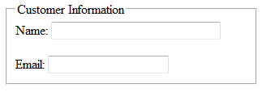
The Fieldset & Legend Elements
The Fieldset Element <fieldset>
Container tag
Creates a visual group of form controls on a web page
The Legend Element <legend>
Container tag
Creates a text label within the fieldset
<fieldset><legend>Customer Information</legend>
<label>Name: <input type="text" name="CName" id="CName" size="30"></label> <br><br >
<label>Email: <input type="text" name="CEmail" id="CEmail"></label>
</fieldset>

Slide 60
The Input Element Hidden Field <input>
This form control is not displayed on the Web page.
Hidden form fields
Can be accessed by both client-side and server-side scripting
Common Attributes:
type=“hidden”
name
id
value

Slide 61
Submission Button
When user clicks on the “Submit” button, the content of the form is sent to another file.
<form name="input" action="html_form_action.asp" method="get"> Username: <input type="text" name="user">
<br>
<input type="submit" value="Submit">
</form>
Output
Username:
Notes:
Another type of input field is the SUBMIT type, this tells the browser to draw a button. When the user clicks on the button the browser knows to submit the contents of the form to the URL specified as the ACTION in the form tag.
Submit inputs support the attribute VALUE which is the string you want displayed in the button. If you don't include a VALUE attribute the browser will put the string "Submit" in the button. Note that the NAME attribute is not required for a submit input.

Slide 62
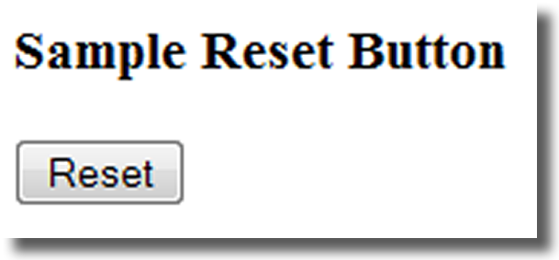
The Input Element Reset Button <input>
Resets the form fields to their initial values
Attributes:
type=“reset”
name
id
value

Slide 63
Checkboxes
Used when you want the user to select one or more options of a limited number of choices.
<form>
<input type="checkbox" name="bike“ value=“bike”> I have a bike
<br>
<input type="checkbox" name="car“ value=“car”> I have a car </form>
Output
I have a bike
I have a car
Notes:
Inputs of type CHECKBOX present user with an item that can be selected or deselected. Each checkbox has a name and a value and can be initially selected/deselected.

Slide 64
Radio Buttons
Used when you want the user to select one of a limited number of choices.
<form>
<input type="radio" name=“gender" value="male"> Male
<br>
<input type="radio" name=“gender" value="female"> Female </form>
Output
Male
Female
Notes:
Radio Button inputs are like checkboxes, except that the user must select only one item from group of choices.

Slide 65
Text Area
Used when you want to get input from user.
<form>
<p>Please provide your suggestion in the text box below:</p>
<textarea rows=“10” cols=“30”>
</textarea>
</form>
Output
Please provide your suggestion in the text box below:
Common Attributes:
name
id
cols
rows
Notes:
You can create a multiline text field with the TEXTAREA tag. The TEXTAREA tag requires the NAME attribute and supports the attributes ROWS and COLS (to define the size of the box drawn on the screen). Unlike the INPUT tag - the TEXTAREA tag has an end tag, so you need to include a </TEXTAREa> tag.

Slide 66
Pull-down Menu
Used when you want user to respond with one specific answer with choices you given.
<p>Select a fruit:</p> <select name="Fruit"> <option selected> Apples <option> Bananas < option > Oranges </select>
Output
Select a fruit:
Notes:
The SELECT and OPTION tags can be used to create pull-down menus and scrolling lists of choices. The SELECT tag must include a NAME attribute (this is the name of the form field sent by the browser). Between the <SELECT> tag and the corresponding end tag </SELECT> there can be number of OPTION tags - one for each choice you want displayed. The text that follows the OPTION tag is the text that will be displayed by the browser. The value sent by the browser if a choice is selected can be specified with a VALUE attribute, if none is specified the value sent will be the text that follows the OPTION tag.

Slide 67
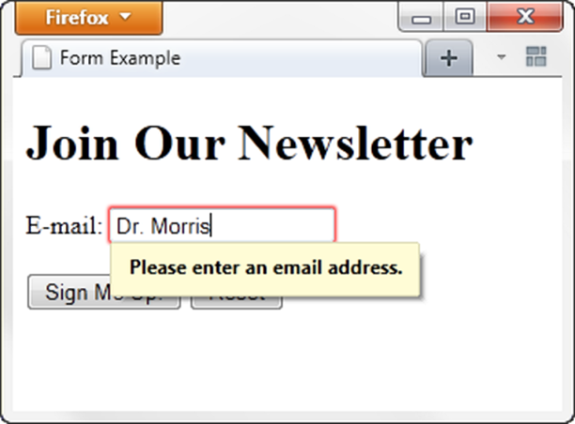
HTML5: Email Text Box<input>
Accepts text information in e-mail address format
Common Attributes:
type=“email”
name
id
size
maxlength
value
placeholder
required

Slide 68
Telephone Number Text Box <input>
Accepts text information in telephone number format
Common Attributes:
type=“tel”
name
id
size
maxlength
value
placeholder
required

Slide 69
Datalist Control
The <datalist> tag specifies an HTML autocomplete feature to be used with a form element. An alternative element is <select>
<datalist> vs <select>:
<select> requires users to choose from the indicated options.
The <datalist> allows users to either choose from the specified answers, or to type in their original ones.

Slide 70
Image Map
An image maps is an image with clickable areas that usually act as hyperlinks.
The image is defined by the <img> tag, and the map is defined by a <map> tag with <area> tags to denote each clickable area.
Use the usemap and name attributes to bind the image and the map.

Slide 71
<img src="http://jaced.com/blogpix/2007/trisquarecircle/002.gif" usemap="#shapes">
<map name="shapes">
<area shape="polygon" href="http://www.google.com" coords="79,6,5,134,153,134">
<area shape="rectangle" coords="177,6,306,134">
<area shape="circle" coords="397,71,65">
</map>

Slide 72
<marquee>
<marquee> tag is used for scrolling piece of text or image displayed either horizontally across or vertically down your web site page depending on the settings.

Slide 73
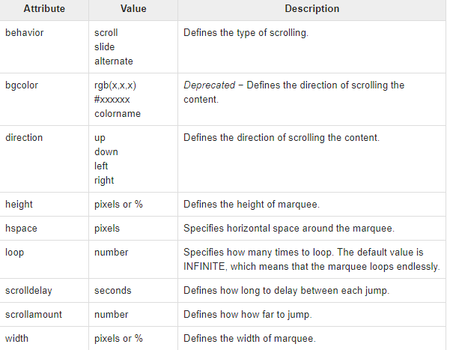
Attributes of <marquee>

Slide 74
<audio>
HTML5 provides a new standard for embedding an audio file on a web page.
We can embed an audio file to a page using the <audio> element:
<audio controls>
<source src="file.mp3" type="audio/mpeg">
Your browser does not support the audio element.
</audio>

Slide 75
<video>
We can embed also a video to a webpage using the <video> element:
<video width="500" height="700" controls>
<source src="video.mp4" type="video/mp4">
Your browser does not support the video tag.
</video>

Slide 76
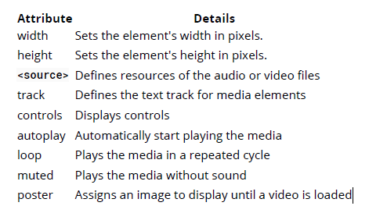
Attributes of <audio> and <video>

Slide 77
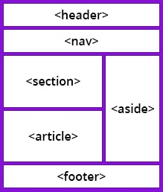
Simple Layout of HTML5

Slide 78
<header>
The <header> element is one of several new semantic document tags introduced with HTML5.
It is used to define a header section for the element that contains it.
It can be used as a header for a whole page (the most common usage), but can also be used as the header for an article or any other piece of on-page content.

Slide 79
<nav>
The <nav> element is primarily intended to be used for sections that contain main navigation blocks for the website, this can include links to other parts of the web page (e.g. anchors for a table of contents) or other pages entirely.

Slide 80
<section>
The HTML <section> tag is used to define sections in a document.
The <section> element is a structural HTML element used to group together related elements.
Each <section> typically includes one or more heading elements and additional elements presenting related content.
When we place our content on a web page, it may contains many chapters, headers, footers, or other sections on a web page that is why HTML <section> tag is used.
HTML <section> is a new tag introduced in HTML5.

Slide 81
<article>
The <article> element contains self-contained content like articles, blog posts, user comments or an interactive widget that could be distributed outside the context of the page.
When article elements are nested, the contents of the inner article node should be related to the outer article element.

Slide 82
<aside>
<aside> element represents a portion of a document whose content is only indirectly related to the document's main content.
Asides are frequently presented as sidebars or call-out boxes.

Slide 83
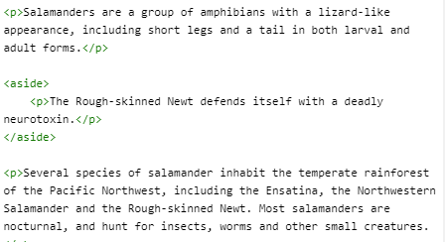
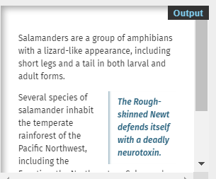

Slide 84
<figure>
<figure> tag is used to mark up a photo in the document on a web page.
As we know image tag is already available in HTML to display the pictures on web pages.
But HTML 5 <figure> tag is used to handle the group of diagrams, photos, code listing etc. with some embedded content.
We can also add a caption for the photo with the help of <figcaption> tag.
HTML figure is new a new tag introduced in HTML5.

Slide 85
<main>
The <main> element contains the main content for your web page.
This content is unique to the individual page, and should not appear elsewhere on the site.
Repeating content like headers, footers, navigation, logos, etc., is placed outside the element.
<main> element should only ever be used at most once on a single page.
<main> element must not be included as a descendant of an article, aside, footer, header or nav element.
The <header> and <footer> tags are siblings to the <main> element.

Slide 86
<footer>
The <footer> element contains the footer part of the page.
Here is an example for <footer> element that contain p paragraph tag.
<footer>
<p>All rights reserved</p>
</footer>

Slide 87
HTML
Frames

Slide 88
FRAMES
Frames divide browser windows into several independent sections that can each contain a separate HTML document.
Most commonly, frames divide the window into two or more sections, with one larger section containing content and the smaller section(s) containing a logo, navigation links, or both.

Slide 89
Creating Frames - Steps
Create a FRAMESET (or layout) document that determines the location and characteristics of the frames.
Designate the Frames and their contents.
Format the Frames.
Make provisions for Frames when viewed in non framed browsers.

Slide 90
Tags and Attributes
Tag / Attribute | Use
<FRAMESET> | Establishes frames within an html document
ROWS=“n1,n2,…” | Sets the size for rows – horizontal frames – in pixels, as a percentage, or as a proportion of remaining space with “*”
COLS=“n1,n2,…” | Sets the size for columns – vertical frames
<FRAME> | Identifies frame characteristics and initial content
SRC=“…” | Identifies source for frame content (URL)
NAME=“…” | Labels a frame (used to target from other frames)
<NOFRAMES> | Sets a section of document to be visible to non framed browsers and invisible to framed browsers

Slide 91
Formatting Frames
Formatting a frame primarily involves :
Removing borders
Specifying border width
Specifying border color
Setting frame margins
Controlling frame size
Controlling scrollbars
The attributes for the above, generally apply either to a <FRAMESET> tag or to individual <FRAME> tags, although HTML 4 specification only supports using these attributes with individual <FRAME> tags.

Slide 92
Frame Formatting Attributes
Attribute | Use
FRAMEBORDER=“…” | Sets or removes border around a frame (HTML 4 standard and Microsoft usage)
BORDER=“…” | Sets or removes border around a frame (Netscape usage)
BORDERCOLOR=“…” | Sets the color of frame border
MARGINHEIGHT=“…” | Sets the margin above or below frame content in pixels
MARGINWIDTH=“…” | Sets the margin to the left or to the right of content in pixels
NORESIZE | Prohibits visitors from resizing a frame
SCROLLING=“…” | Prohibits (NO), requires (YES), or lets browser provide (AUTO) scrollbars

Slide 93
Accommodating Non-Framed Browsers
To accommodate visitors using non-framed browsers, use the <NOFRAMES> tag and include the alternate text.

Slide 94
Advantages of Using Frames
One of the most beneficial feature of frames is it lets the user to have multiple pages in the same browser.
Using frames we can keep one part of the page static while changing the other parts of the page.
If we create a top frame we can use it as a header i.e, as that page is static it acts like an include page.
Frames can be used to reduce server load, as there is no need to reload all the pages when ever a new page is visited.

Slide 95
Disadvantages of Using Frames
Frames can make the production of website complicated.
A user is unable to bookmark any of the Web pages viewed within a frame.
The browser’s back button might not work as the user hopes.
The use of too many frames can put a high workload on the server.
Many old web browser doesn’t support frames.
Note: This tag is not supported in HTML5.

Slide 96
Inline Frames
Inline frames, often called Floating frames, allow you to insert an HTML document into an area within another document.
Tags and Attributes :
Tag / Attribute | Description
<IFRAME> | Identifies frame characteristics and initial content
SRC=“…” | Identifies source for frame content (URL)
NAME=“…” | Labels a frame (used to target from other frames)
FRAMEBORDER=“…” | Sets or removes border around a frame

Slide 97
Inline Frame tags and Attributes – contd.
Tag / Attribute | Description
SCROLLING=“…’ | Prohibits (NO), requires (YES), or lets browser provide (AUTO) scrollbars
MARGINHEIGHT=“…” | Sets the margin above or below frame content in pixels
MARGINWIDTH=“…” | Sets the margin to the left or to the right of frame content in pixels
HEIGHT=“…’ | Specifies the height of an inline frame in pixels
WIDTH=“…” | Specifies the width of an inline frame in pixels
ALIGN=“…” | Specifies alignment as LEFT, RIGHT, TOP, MIDDLE, or BOTTOM

Slide 98
HTML
Chapter 7
Cascading Style Sheets

Slide 99
What is CSS?
A simple mechanism for controlling the style of a Web document without compromising its structure.
It allows you to separate visual design elements (layout, fonts, colors, margins, and so on) from the contents of a Web page.
Allows for faster downloads, streamlined site maintenance, and global control of design attributes across multiple pages.

Slide 100
Why use Style Sheets?
separate structure from appearance
create consistent appearance
ease of maintenance
increase accessibility
apply additional effects
reduce use of non-standard tags
reduce web page file size

Slide 101
CSS vs. just HTML
What can we do with CSS that we can’t do with HTML?
Control of backgrounds.
Set font size to the exact height you want.
Highlight words, entire paragraphs, headings or even individual letters with background colors.
Overlap words and make logo-type headers without making images.
Precise positioning.
Linked style sheets to control the look of a whole website from one single location.
And more.

Slide 102
Rules have two parts: a selector and a declaration
The selector tells a browser which elements in a page will be affected by the rule. There are a number of different types of selector.
The declaration tells the browser which set of properties to apply. There are many different properties.

Slide 103
How to write CSS?
Selector
HTML element tags (examples: p, h2, body, img, table)
class and ID names
Property (examples: color, font-size)
Value (examples: red, 14pt)

Slide 104
How to write CSS:
The basic syntax of a CSS rule:
selector {property 1: value 1; property 2: value 2}
Example:
p {font-size: 8pt; color: red}
Notice the { } around the rule and the : before each value!

Slide 105
Three ways to include CSS:
Local (Inline)
Global (Embedded, or Internal)
Linked (External)

Slide 106
1. Local
Inline style sheet.
Placed inside tags.
Specific to a single instance of an html tag on a page.
Must be used instead of <font> tags to specify font size, color, and typeface and to define margins, etc.
Use to override an external or embedded style specification.

Slide 107

Local (inline)
Example
<p style="font-size: 10pt; color: red; font-weight: bold; font-family: Arial, Helvetica, sans-serif">
This is a local stylesheet declaration. </p>
On the browser:

Slide 108
2. Global
Embedded or internal style sheet
Applicable to an entire document
Styles are defined within the <style> </style> tag, which is placed in the header of the html file (i.e., within <head> and </head>).

Slide 109
Global (Internal)
Example:
<html> <head> <title>Title</title> <style type="text/css"> <!--[STYLE INFORMATION GOES HERE] --> </style> </head>
<body> [DOCUMENT BODY GOES HERE] </body>
</html>

Slide 110
3. Linked
External style sheet
Styles are saved in a separate file, with the extension .css
This single stylesheet can be used to define the look of multiple pages.

Slide 111
Linked (External)
Example
Save this text file as whatever.css
In TextPad,Notepad, etc.…
p {font-family: verdana, sans-serif; font-size: 12pt; color: red}
h1 {font-family: serif; font-size: 14pt; color: green}
h2 {font-family: serif; font-size: 11pt; color: blue}

Slide 112
Linked (External)
Example (continued)
To apply the stylesheet “whatever.css“ to an HTML document, call it in from the header:
<head> <link rel="stylesheet" href=“whatever.css" type="text/css">
</head>

Slide 113
Grouping properties
Separate properties with a semi-colon
Example:
p {text-align:center;color:red; font- family:Arial; font-style:italic}

Slide 114
Grouping selectors
Separate selectors with a comma
Example:
h1,h2,h3,h4,h5,h6 { color: green }
(each header will be green)
Separate selectors with a space
Example:
p li { color: red }
(only items within a list and a paragraph tag will be red)

Slide 115
The class Selector
With a class selector you can define different styles for the same type of HTML element
Examples:
First define the class:
p.right {text-align: right; color: red; font-style: italic}
p.blue {text-align: center; color:blue}
Then use the class in your HTML code :
<p class="right"> This paragraph will be right-aligned, italic, and red. </p>
<p class=“blue"> This paragraph will be center-aligned and blue. </p>

Slide 116
The class Selector
You can also omit the tag name in the selector to define a style that will be used by all HTML elements that have this class.
Example:
.poem {text-align: center; font-style:italic}
Any HTML element with class=“poem" will be center-aligned and italic.

Slide 117
The class Selector
Example (continued)
Both elements below will follow the rules in the ".poem“ class:
<h1 class=“poem"> This heading will be center-aligned and italic </h1>
<p class=“poem"> This paragraph will also be center-aligned and italic. </p>

Slide 118
Class Example
<style>
p {font-family: sans-serif; font-size: 10pt} h1 {font-family: serif; font-size: 30pt} h2 {font-family: serif; font-size: 24pt} .boldred {color: red; font-weight: bold} .green {color: green} .tinyblue {color: blue; font-size: 8pt}
</style>
The tags and classes can then be used in combination:
<h1 class=“boldred">This is rendered as 30-point red serif bold text.</h1>
<p class=“boldred">This is rendered as 10-point red sans-serif bold text.</p>

Slide 119
List of style Selectors and their Properties and Values:
From WDG:
http://www.htmlhelp.com/reference/css/properties.html

Slide 120
Properties-Background
background-color
Hex
background-image
URL(image.jpg)
background-repeat
No-repeat, repeat-x, repeat-y
background-attachment
Fixed, scroll
background-position
Top, left
p { background-position: 70px 10px; background-repeat: repeat-y; background-image: url(background.gif) }
Example

Slide 121
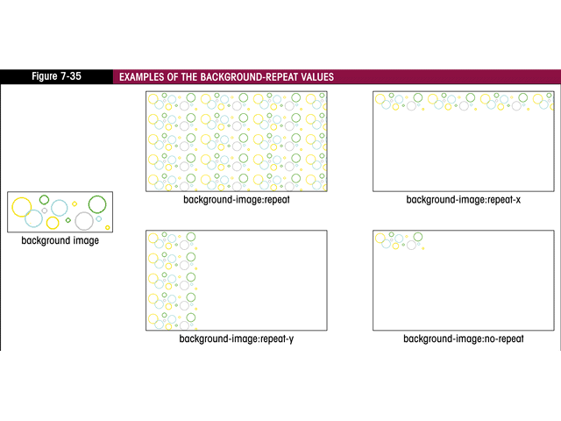
Background repeat examples:

Slide 122
Properties - Font
font-family
Name, or serif, sans-serif, cursive, monospace
font-style
normal, italic
font-weight
normal, bold, 100, 200, 300, 400, 500, 600, 700, 800, 900
font-size
absolute-size, relative-size, length, percentage
font-variant
small-caps

Slide 123
Properties - Text
text-decoration
underline, line-through
text-transform
capitalize, uppercase, lowercase, none
text-align
left, right, center, justify
text-indent
<length>, <percentage>

Slide 124
Link Style
a:link {color: #FFFFFF; text-decoration: none}
a:visited {color: #808080; text-decoration: none}
a:hover {color: red; text-decoration: none}

Slide 125
Selector Forms:
A selector is a pattern that is used to select an element to apply the CSS style rules.
CSS selectors are used to select the content you want to style.
Selectors can be used as a condition or a CSS rule to determine the elements that match with the selector.
Types of selectors:
CSS Element Selector
CSS Id Selector
CSS Class Selector
CSS Universal Selector
CSS Group Selector

Slide 126
CSS Element Selector
The element selector selects the HTML element by name.
p{
text-align: center;
color: blue;
}

Slide 127
CSS Id Selector
The id selector selects the id attribute of an HTML element to select a specific element. An id is always unique within the page so it is chosen to select a single, unique element.
It is written with the hash character (#), followed by the id of the element.
#para1 {
text-align: center;
color: blue;
}

Slide 128
The CSS class Selector
The class selector selects HTML elements with a specific class attribute.
To select elements with a specific class, write a period (.) character, followed by the class name.
.center {
text-align: center;
color: blue;
}

Slide 129
CSS Class Selector for specific element
If we want to specify that only one specific HTML element should be affected then you should use the element name with class selector.
p.center {
text-align: center;
color: blue;
}

Slide 130
CSS Universal Selector
The universal selector is used as a wildcard character. It selects all the elements on the pages.
* {
color: green;
font-size: 20px;
}

Slide 131
Grouping Styles and Selectors
Styles can be grouped:
Using multiple styles
Using multiple selectors
Using contextual selectors
Using direct child selectors
Using adjacent selectors
By attribute

Slide 132
Grouping Styles and Selectors
Each rule can include multiple styles using semicolons to separate them:
h2 { color: darkblue; font-style: italic;}
Additionally, multiple selectors that have the same styles can be grouped using commas to separate them:
h1, h2, h3 { color: yellow; }

Slide 133
Grouping Styles and Selectors
Contextual selectors allow you to specify that something will occur when it is used in conjunction with something else. In the style below, strong will be displayed in red, but only when it occurs within li within ul.
ul li strong { color: red;}
Elements being modified by contextual selectors need not appear immediately inside one another. For example, using this style, blah would still be red text: <ul><ol><li><strong> blah </strong></li></ol></ul>

Slide 134
Grouping Styles and Selectors
Direct child selectors allow you to specify that something will change, but only when immediately inside of another element. With the following style, only those strong elements that are directly inside of an h1 will be purple. No strong tags deeper within the sheet will be purple.
h1 > strong { color: purple;}

Slide 135
Grouping Styles and Selectors
Adjacent selectors allow you to specify that something will change only when preceded by something else. In the style below, only those links (a) that are preceded by an h2 will be green.
h2 + a { color: green;}
Elements being modified by adjacent selectors appear immediately after one another. Using this style, this link would be green: <h2>Visit Stanford!</h2> <a href="http://www.stanford.edu">click here</a> This link would not: <h2>Visit Stanford! <a href="http://www.stanford.edu">click here</a></h2>

Slide 136
Grouping Styles and Selectors
You can also group selectors by attribute. With the style below, text that is centered using h2 tags (<h2 align="center">) display surrounded by a dotted border:
h2[align="center"] { border: dotted;}

Slide 137
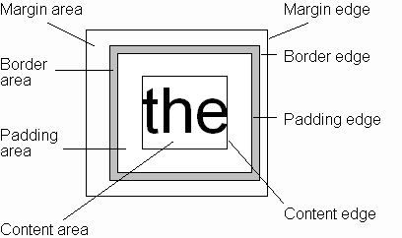
CSS Box Model
Every rendered element occupies a box:
(or outer edge)
(or inner edge)

Slide 138
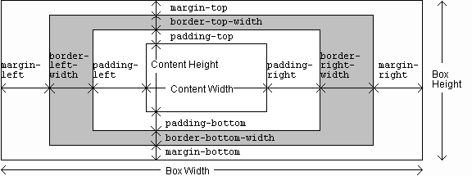
CSS Box Model

Slide 139
CSS Box Model
Every element that can be displayed on a web page is comprised of one or more rectangular boxes.
CSS box model typically describes how these rectangular boxes are laid out on a web page.
These boxes can have different properties and can interact with each other in different ways, but every box has a content area and optional surrounding padding, border, and margin areas.

Slide 140
CSS Box Model
Content Area: This area consists of content like text, image, or other media content. It is bounded by the content edge and its dimensions are given by content box width and height.
Border Area: It is the area between the box’s padding and margin. Its dimensions are given by the width and height of border.
Margin Area: This area consists of space between border and margin. The dimensions of Margin area are the margin-box width and the margin-box height. It is useful to separate the element from its neighbors.
Padding Area: It includes the element’s padding. This area is actually the space around the content area and within the border box. Its dimensions are given by the width of the padding-box and the height of the padding-box.

Slide 141
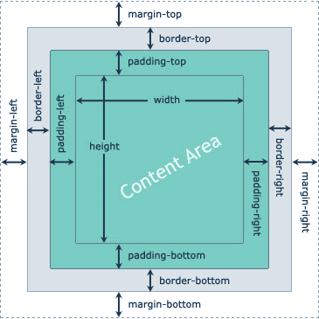
CSS Box Model

Slide 142
Grouping HTML Elements:
There are two important tags which we use very frequently to group various other HTML tags
(i) <div> tag
(ii) <span> tag

Slide 143
<div>
The <div> tag is known as Division tag. The <div> tag is used in HTML to make divisions of content in the web page like (text, images, header, footer, navigation bar, etc).
Div tag has both open(<div>) and closing (</div>) tag and it is mandatory to close the tag.
<div> tag is Block level tag
It is a generic container tag
It is used to the group of various tags of HTML so that sections can be created and style can be applied to them.

Slide 144
<span>
<span> tag is used as a generic container of inline elements. It is used for styling purpose to the grouped inline elements (using class and id attribute or inline style).
The <span> tag does not have any default meaning or rendering.
The <span> tag can be useful for the following task:

Slide 145
<span>
To change the language of a part of the text.
To change the color, font, background of a part of text using CSS
To apply the scripts to the particular part of the text.
Note: <span> is much similar as <div> tag, but <div> is used for block-level elements and <span> tag is used for inline element

Slide 146
HTML Character Entities
Some characters are reserved in HTML. Reserved characters in HTML must be replaced with character entities.
If you use the less than (<) or greater than (>) signs in your text, the browser might mix them with tags.
Character entities are used to display reserved characters in HTML.
A character entity looks like this:
&entity_name; OR &#entity_number;
To display a less than sign (<) we must write:
&lt; or &#60;

Slide 147
Non-breaking Space
A commonly used entity in HTML is the non-breaking space: &nbsp;
A non-breaking space is a space that will not break into a new line.
Two words separated by a non-breaking space will stick together (not break into a new line). This is handy when breaking the words might be disruptive.
Another common use of the non-breaking space is to prevent browsers from truncating spaces in HTML pages.

Slide 148
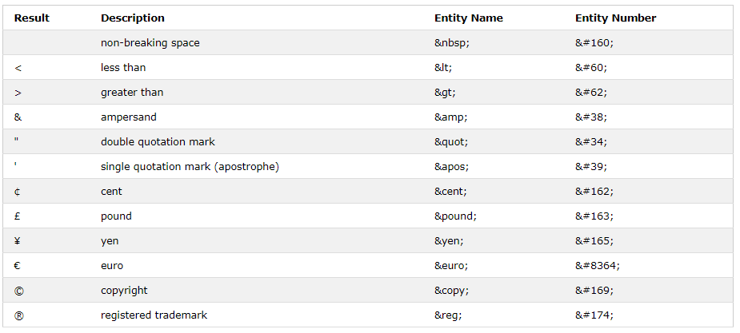
Some Useful HTML Character Entities

Slide 149
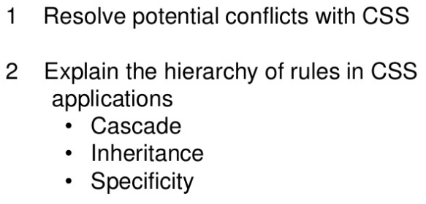
Conflict Resolution

Slide 150
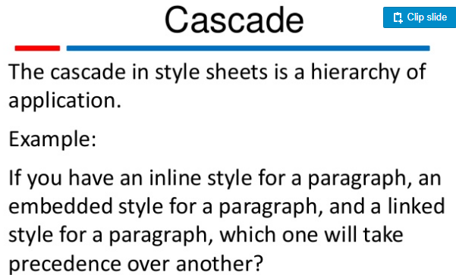

Slide 151
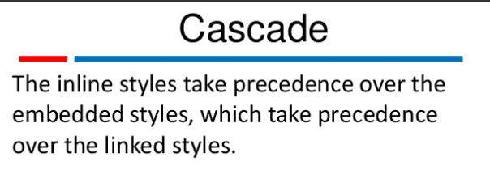

Slide 152
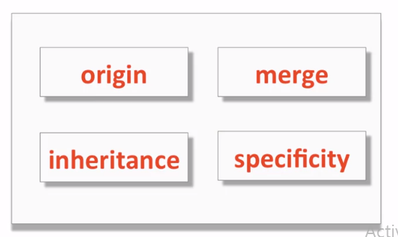
Conflict Resolution

Slide 153
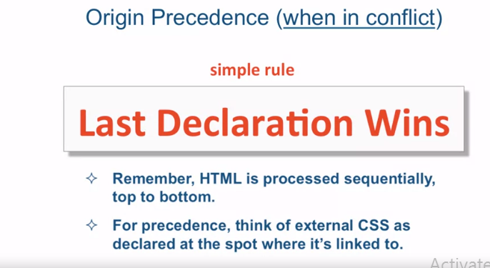
Origin

Slide 154
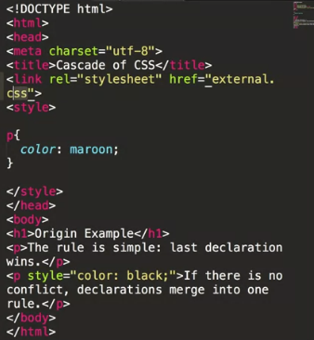

Slide 155
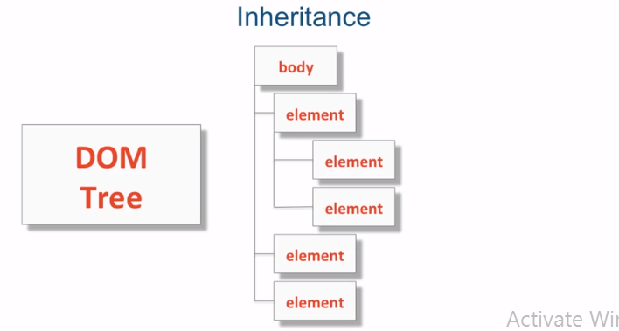

Inheritance

Slide 156
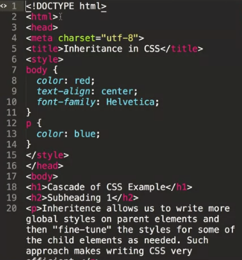
Inheritance Example

Slide 157
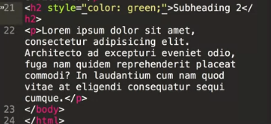
Inheritance Examples

Slide 158
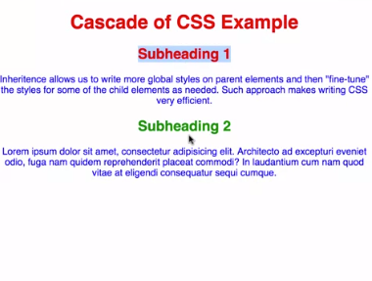
Output

Slide 159

Specificity

Slide 160
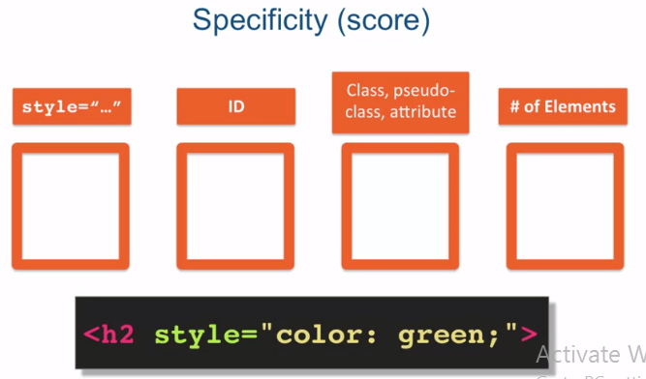
Specificity (Score)

Slide 161
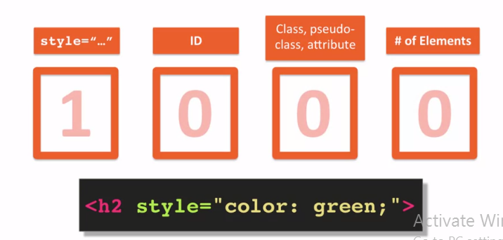
Specificity (Score)

Slide 162
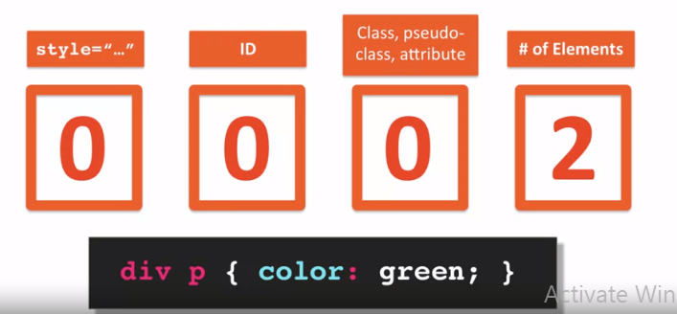
Specificity (score)

Slide 163
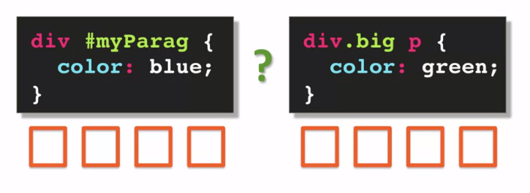
Specificity (score)

Slide 164
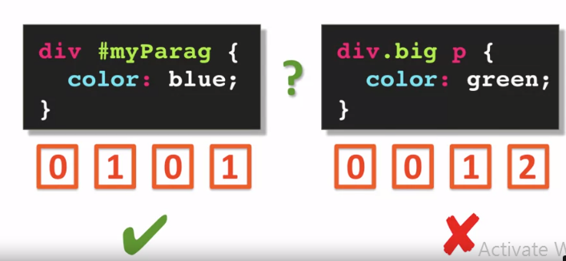
Specificity Score

Slide 165
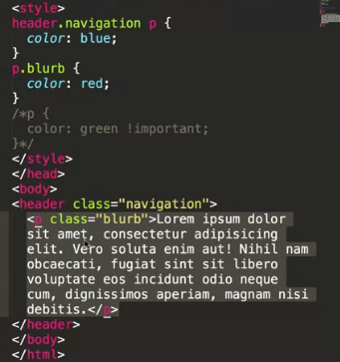
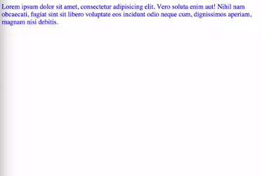
Example
Output:

Slide 166
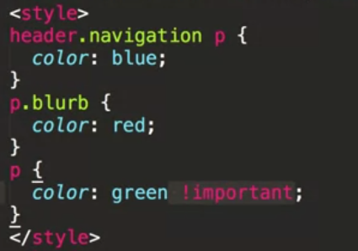
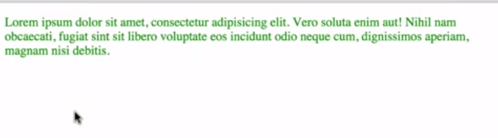
Output:

